Slide 1
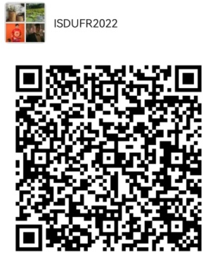
Wechat Group
曲靖师范学院真菌资源开发与利用国际学术研讨会通知
International Conference on Development and Utilization of Fungal Resources 2022
26-27 October 2022
Qujing Normal University, Qujing, Yunnan, China
曲靖师范学院真菌资源开发与利用国际学术研讨会通知
Poster presentation
All posters will be printed locally and presented in the morning sessions (agenda forthcoming). If you will not be physically present at Qujing Normal University, but if you wish to present your poster to the audience, you have the option of recording a 3 minutes video which will be shown to the participants.
IMPORTANT:
Use the template (vertical format, 180 cm × 80 cm)
Insert a clear title (Font size 60-80 pts.)
Define your key messages and main results (Font size 30-40 pts.)
Minimum text size 20 points
Include graphics followed by explanations
Send a PDF document as the final
Please also send the .ppt file in case changes are requested
Include your name and email for further contact
Indicate your role in the project
To upload multiple files (PDF, PPT and/or video, please ZIP all files together)
A0 = 180 cm × 80 cm
Your title here
The Center for Yunnan Plateau Biological Resources Protection and Utilization, College of Biological Resource and Food Engineering, Qujing Normal University, Qujing, Yunnan 655011 P.R. China
Tel: +86 13013467425
Email: ICDUFR2022@outlook.com

